Slide 1
Advisor Websites: The Right Design + The Right Content = Success
Andy Klausner & Angela Nielsen
November 17, 2010

Slide 2
Successful Advisor Websites
Design – How a website looks and functions
Does it reflect your brand?
Is it easy to navigate?
Content – What the text says and how it looks
Does it differentiate you?
Does it provide a solution?
Design and Content are interrelated
Do they draw the readers eye in?
Is your message conveyed effectively?

Slide 3
Why Does Design Matter?
The blink of an eye, 1/20th of a second
If the first impression is negative, you’ll drive people off
Studies prove subconscious decision
Visitors will leave, and not know why

Slide 4
Components Of Good Design
Professional logo
Compelling color palette
Clean navigation
Clear layout
Simple direction to next steps

Slide 5
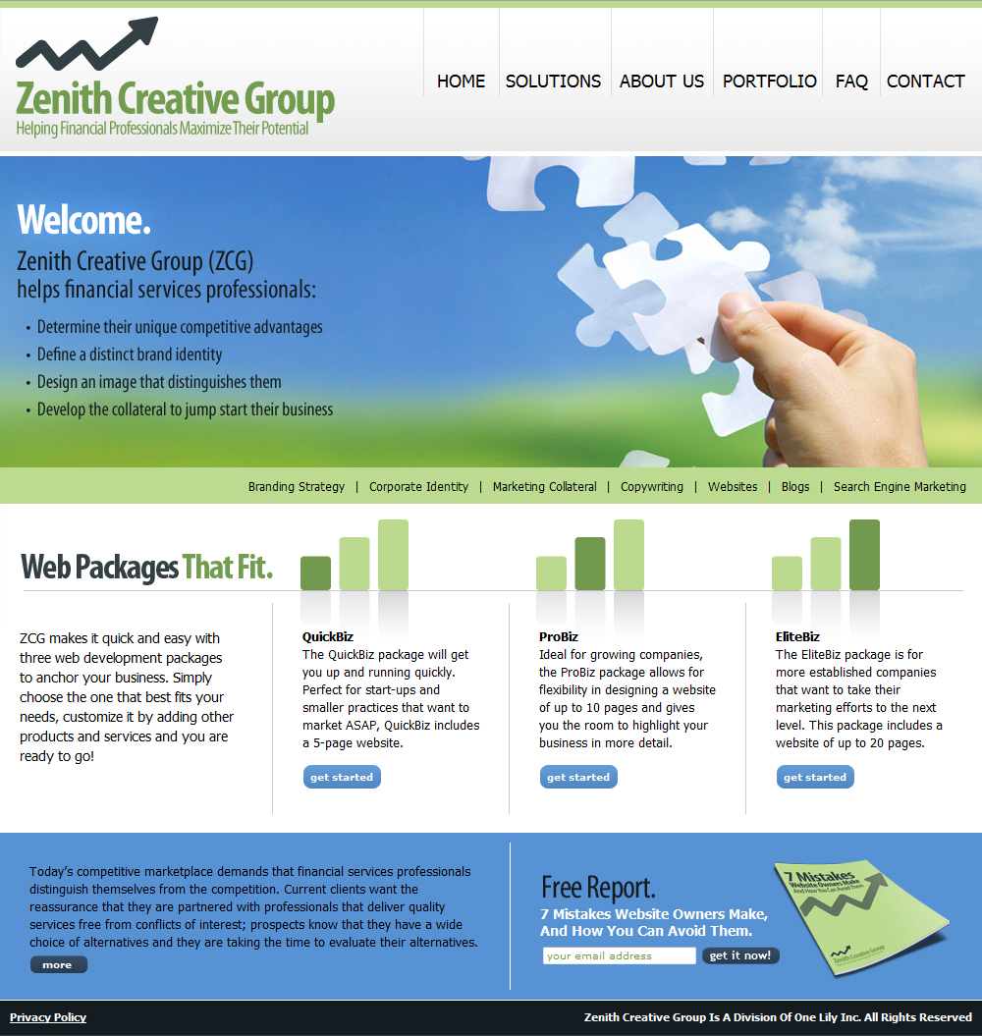
Good Design
Clean
Navigation
Professional Logo
Clear
Layout
Simple
Call To Action

Slide 6
Website Don’ts
Unprofessional logo
Pixilated (blurry) graphics
Music or video that plays on site load
Built in all flash
Unattractive color palette
Not answering WIIFM above the fold

Slide 7
Why Does Content Matter?
You only have 10 seconds to engage the reader
The reader must feel compelled to stay
What you do
Who you help
Why you’re different
People scan – they don’t read
You only get one chance

Slide 8
Effective Content Is…
Rich and exciting
Eye-catching
Headlines
Graphics/Bullet points
Concise
Short paragraphs
Engaging
Pulls the reader in
Call to action

Slide 9
Ineffective Content Is…
Full of jargon
The same as everyone else
Wordy
Long sentences
Long paragraphs
Too uniform
Few or no graphics
Little white space

Slide 10
Home Page – The Key To Success
Eye-catching
Grabs and holds your attention
Establishes your brand image
Drive the reader to dig deeper
Preview of things to come
Engages them – sign-up box
Effectively positions you
Right company/person
Right solutions

Slide 11
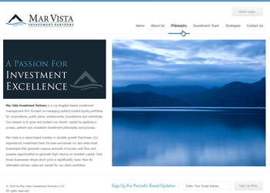
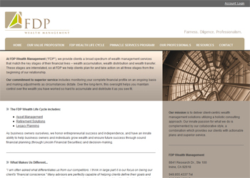
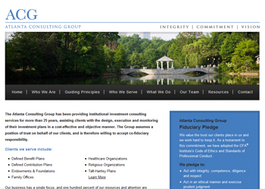
What We’ve Done
“We hired Andy and Angela to assist us in rebranding ourselves and in developing a marketing strategy. The engagement included creating a new brand identity and identifying our unique and distinguishing characteristics. They also rewrote our website and marketing materials to reflect our new direction and executed on the design work on our new corporate identity. Throughout the engagement, they were always available, completed assignments on a timely basis and were willing to go the extra mile for us. I can honestly say that they exceeded my expectations, which is a hard thing to do.”
Mark A. Chandik | Principal | FDP Wealth Management
“Andy and Angela excel at asking the right questions as they solicit the information they need to
construct appropriate solutions. They are patient and accommodating to our needs and timelines
and able to work successfully with diverse personalities. The project was completed right the
first time. We were very happy with their work, and the feedback that we have received has
been quite positive. I recommend them to anyone who is starting a financial services company.”
Neil Campbell | Founder + CEO | FUTR Family Management

Slide 12
Why Zenith?
Current clients want the reassurance that they are partnered with professionals that deliver quality services free from conflicts of interest; prospects know that they have a wide choice of alternatives and they are taking the time to evaluate their alternatives.
ZCG is a collaborative effort between two industry-leading firms that have combined their efforts to make the process as seamless as possible. Andy Klausner, Founder/Principal of AK Advisory Partners, has worked with financial services professionals for more than 25 years and has helped many firms and organizations with their branding efforts. Angela Nielsen, President/Creative Director of One Lily Web Solutions, is well known for her originality and prowess in the design industry, helping hundreds of clients in creating their websites, marketing collateral and corporate identities for over a decade.
Visit ZenithCreativeGroup.com to download your free report…
7 Mistakes Website Owners Make, And How You Can Avoid Them.

